Slide 1
JANUARY CUSTOMER DAY
TEAM CS21

Slide 2
ORIGINAL GOALS
Look into REST protocol alternatives
Begin construction of horizontal scaling plan
Define REST API for communication between compute node and Elastic.
Continue prototype by adding:
Acceleration
Scanning
Shooting
Shield generation
Notes:
2 minutes

Slide 3
REST PROTOCOL ALTERNATIVES
Had a look into gRPC and it seemed to have its advantages:
Performance: Protobuf serializes very quickly on the server
Since gPRC is designed for HTTP/2 it will have significant performance benefits over HTTP 1.x
However we believe that putting protocol buffers can be challenging and a layer of complexity since we need to add support for HTTP/2
We may add it in at the end stages of the project however we are not promising it as of now
We will continue with REST for the time being

Slide 4
DEFINE REST API
(For communication between compute nodes and Elastic )
After meetings on Discord and Zoom, we have decided it would be best to switch from HTTP and no longer use Elastic
We would like to look into using ENet, which is a fast protocol which we would use on top of UDP

Slide 5
HORIZONTAL SCALING
We have not implemented this yet
We have a well defined plan for horizontal scaling. However, as it may take a while to cover we will go over it at the end of the presentation.

Slide 6
PROTOTYPE
We have built a working prototype which:
Connects and disconnects players and their ships using a token ID
Returns the spaceship data for the player’s spaceship from the server
Allows the player to accelerate towards a given x, y coordinate
Scans a given area to check if any other ships are within that area
Allows a player to shoot towards another ship in a given area
Reduce player’s area if they’ve been shot
xUnit and Pytests to ensure that the scan, shoot and movement functions work correctly
We also have death and shielding of a spaceship on a branch but it is not full tested
We shall now demonstrate it working now!

Slide 7
ISSUES
Test coverage was difficult as we use blackbox pytests and most of our methods do not need to return any values
Due to the Christmas break and most people being in different countries, we found it more difficult to work collaboratively and have weekly team meetings
The test cases took us longer than expected as we had to create a sudo API and then use that API to change values of the test cases for each feature

Slide 8
GOALS FOR NEXT ITERATION
Basis of a quadtree implemented to improve horizontal scaling
Have the death and shielding of a spaceship fully working with testing
Judging by previous goals completed and time constraints, we believe that these are the achievable goals for next iteration.
The goals will be documented on our GitLab issue tracker
Are there any other goals you would like us to look into or change for the next iteration?

Slide 9
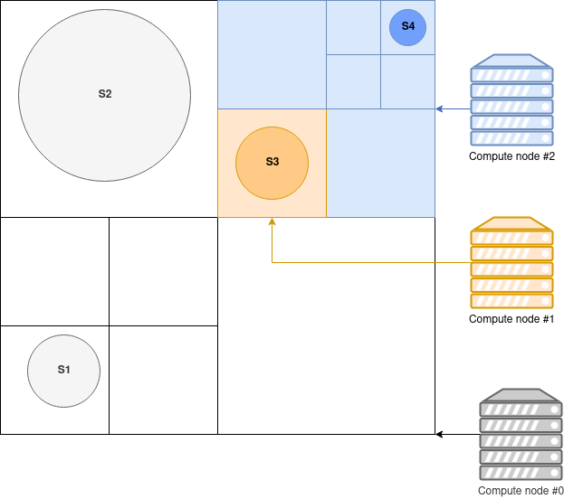
DETAILS - HORIZONTAL SCALING - Quadtree
Each compute node manages a square in the whole game universe
Squares are allocated on a quadtree, recursively splitting
Spaceships receive updates and communicate directly to the node they are located in
A ship with radius ½ * universe size - endgame edge case - would be placed in the root node (that is as big as the universe)

Slide 10
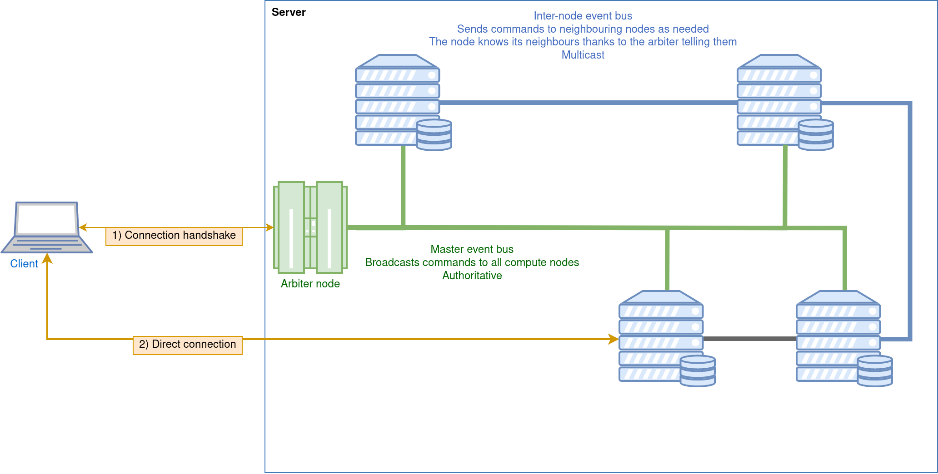
DETAILS - HORIZONTAL SCALING - Network
Nodes communicate via multicast buses with their neighbours and parent as needed.
Ships are transferred (serialized/deserialized) across nodes when they move in/out of quads in the quadtree.
The Arbiter manages all compute nodes and the master event bus.
Clients first connect directly to the arbiter, that assigns them to compute nodes; after that the arbiter always routes specific clients to specific compute nodes.

